Slide 1

BATTERY THERMAL MANAGEMENT USING HEAT PIPE INTEGRATED PELTIER COOLING SYSTEM

Slide 2
Details
Team Lead: ADHITYA LS
Team Members: ARUVI B
ARAVINDH R
Technology Readiness Level: TRL --04
Team Mentor with Designation and Department:
Dr.P.C.MURUGAN
AssOSIATE Professor,
Department of Automobile Engineering,
Kongu Engineering College, Perundurai

Slide 3
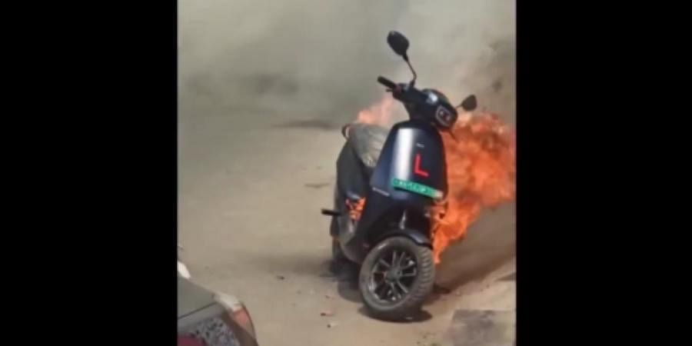

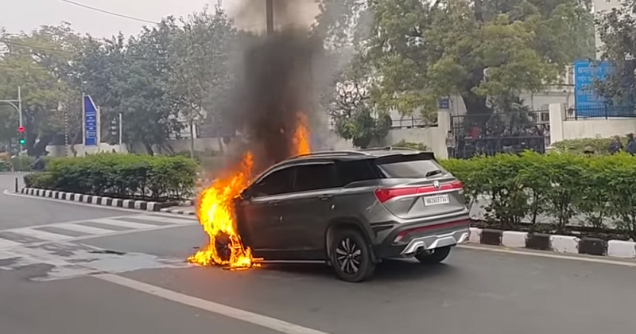
PROBLEM
Battery pack cooling systems consumes Energy from its own cells to maintain its safe and optimal temperature range.
Heat generated from charging and discharging the battery pack reduces its performance and lifespan.
Li-ion battery pack faces difficulty in maintaining optimal temperature due to factors such as ambient temperature, power demand, cooling system and cell design.

Slide 4

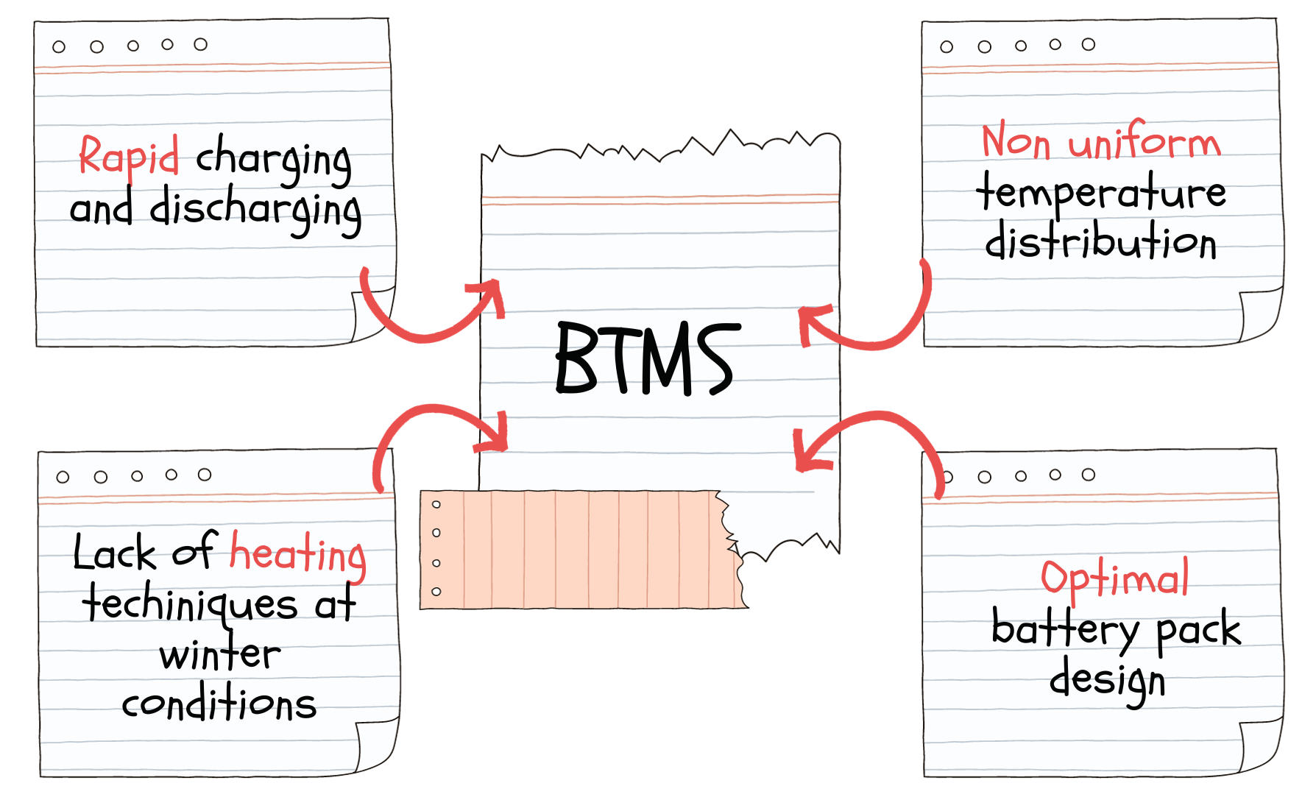
PROBLEM STATEMENT
2

Slide 5

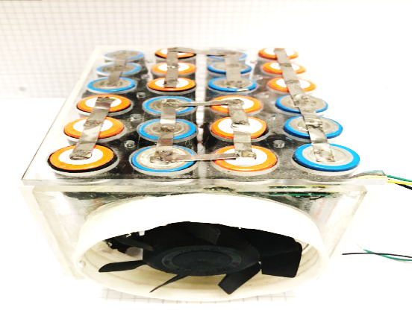
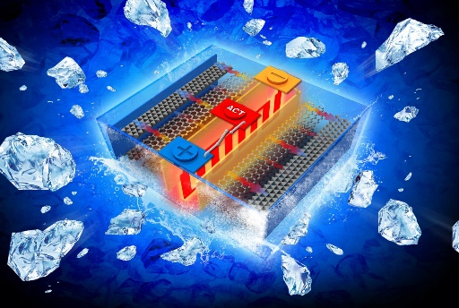


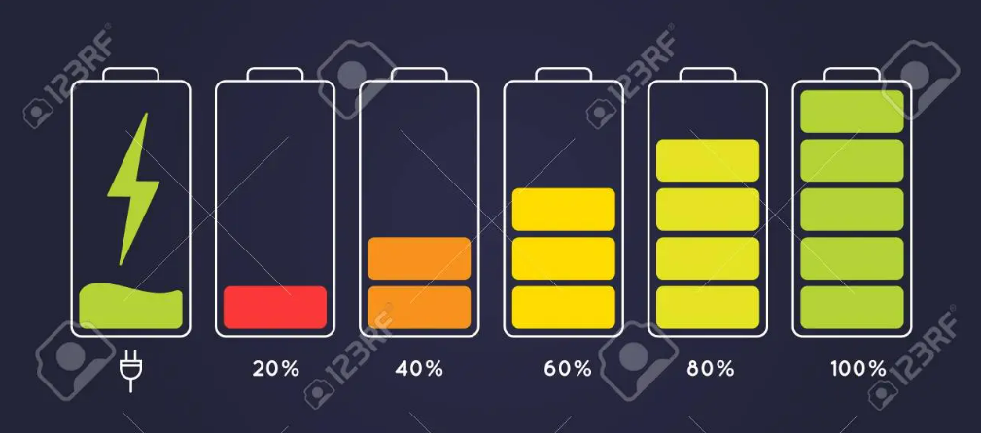

PROBLEM STATEMENT IDEA OVERVIEW
Heating Issues
Existing Technologies
Cooling
Electric Vehicle
Air Cooling
Reasons
Excess Emission From IC fuelled Vehicle
Charging & Discharging
Environmental condition

Slide 6
The Solution
:
EV Battery Thermal Management system using peltier module
System specialized for precise maintenance of battery pack optimal temperature
Using peltier module to maintain EV battery pack optimal temperature range
Dielectric fluid immersion cooling is employed
Heat dissipation from peltier chip is done via heat pipe assisted heatsink fitted with blowers

Slide 7
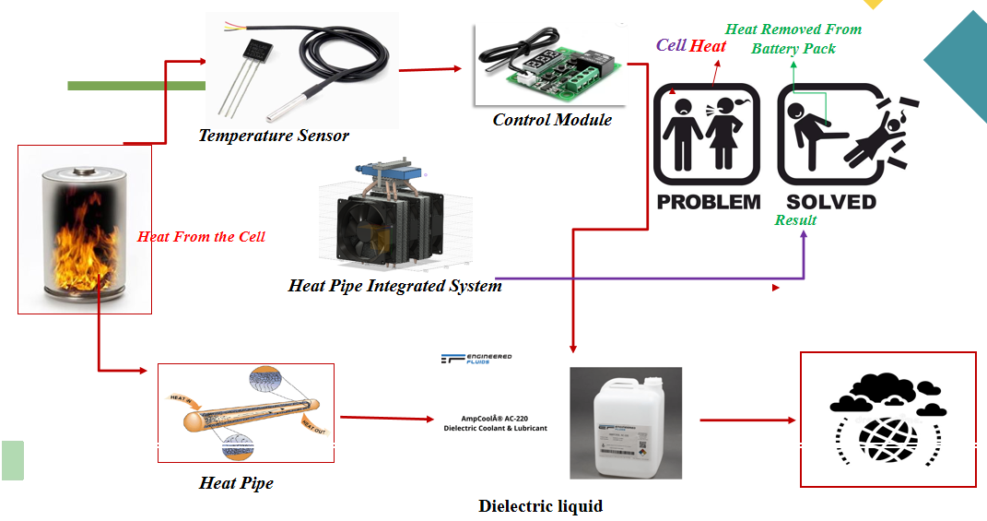
Flowchart/ Product workflow

Slide 8
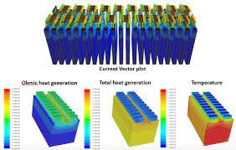
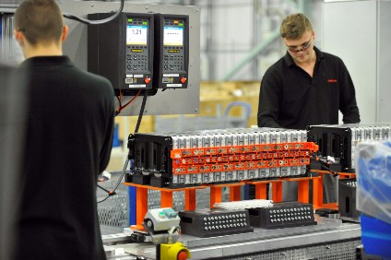
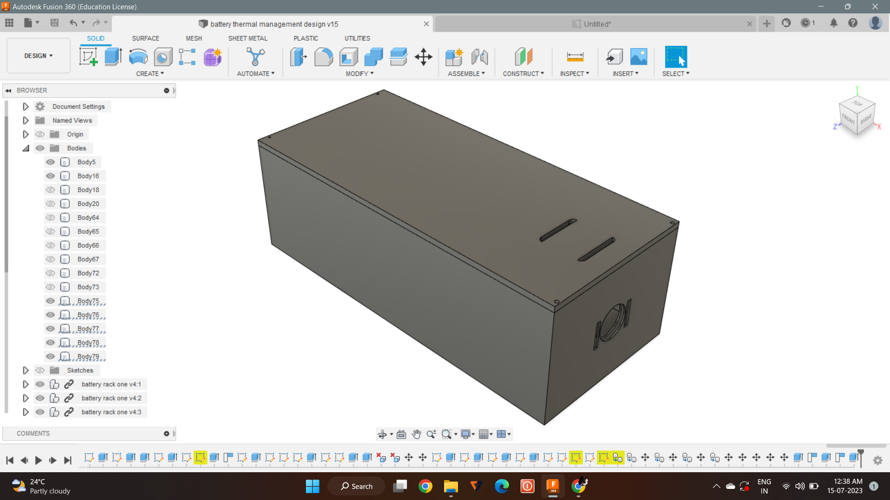
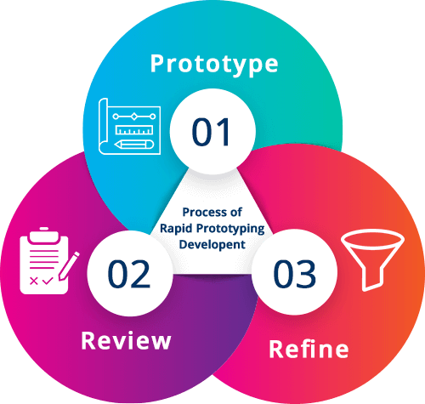
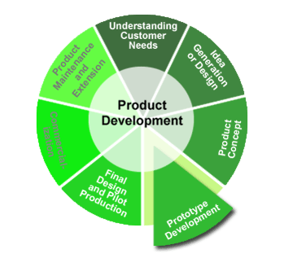
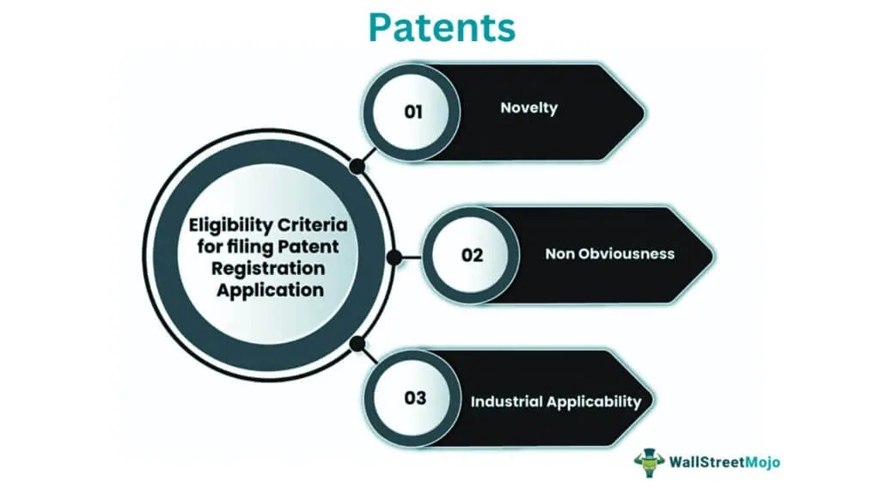
Idea - Current Status / Future Plan Timeline & Milestones
Design upgradation
Thermal and CFD analysis
Gaining inputs from industrial experts

Slide 9
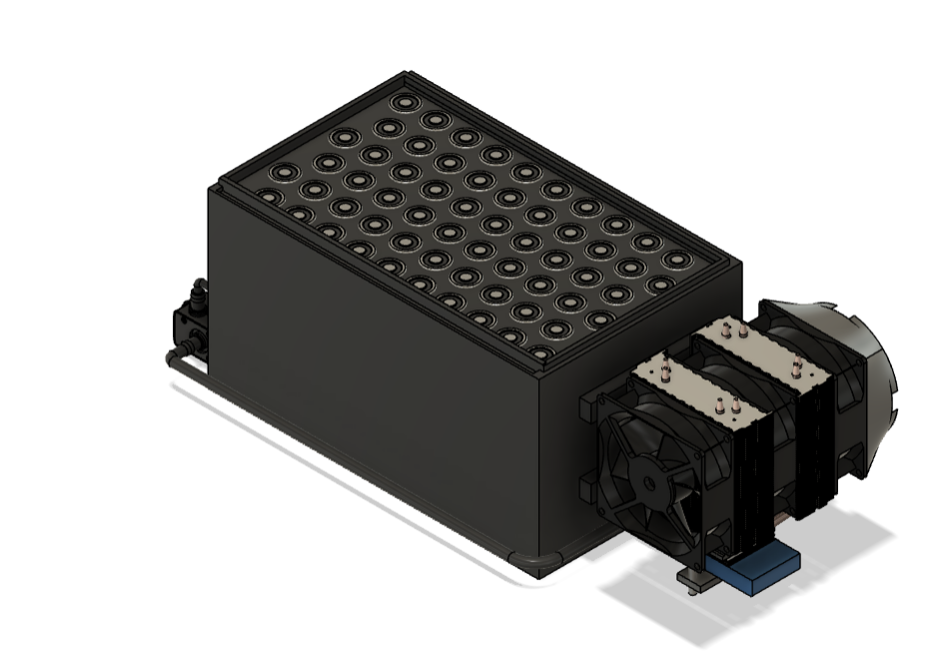
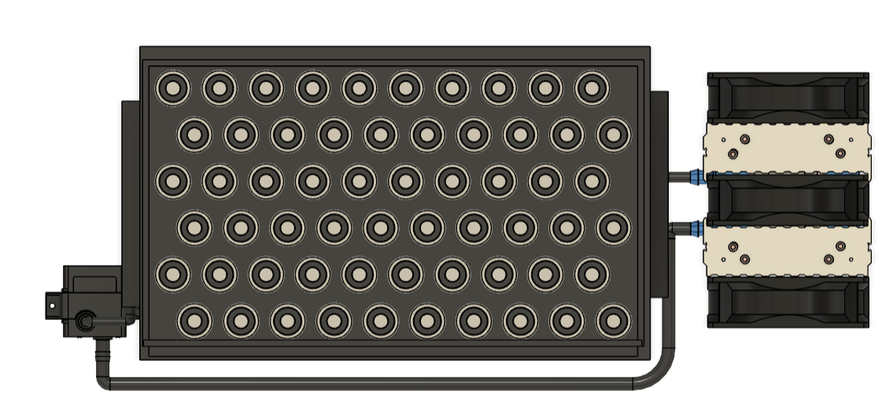
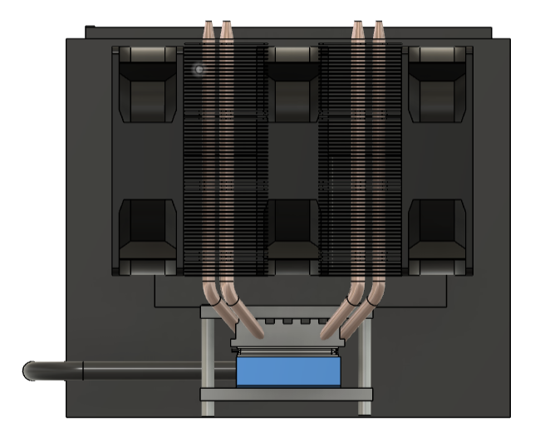
Prototype CAD model

Slide 10
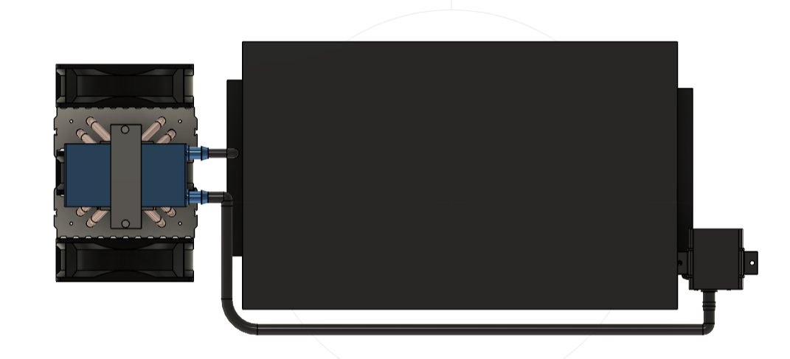
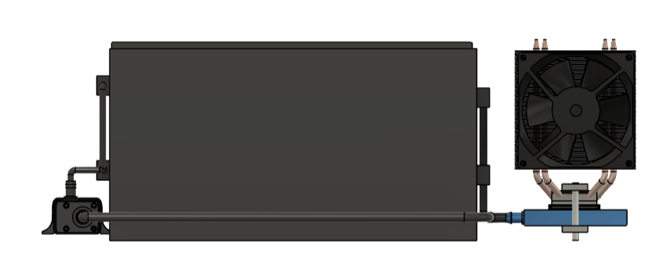

Slide 11
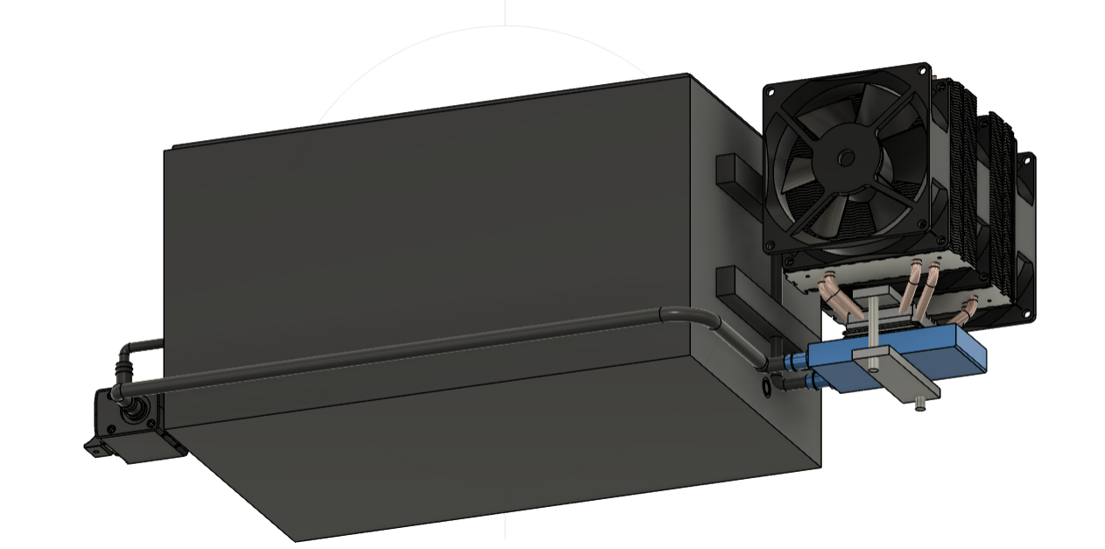

Slide 12
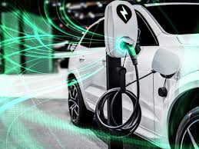


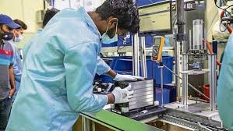


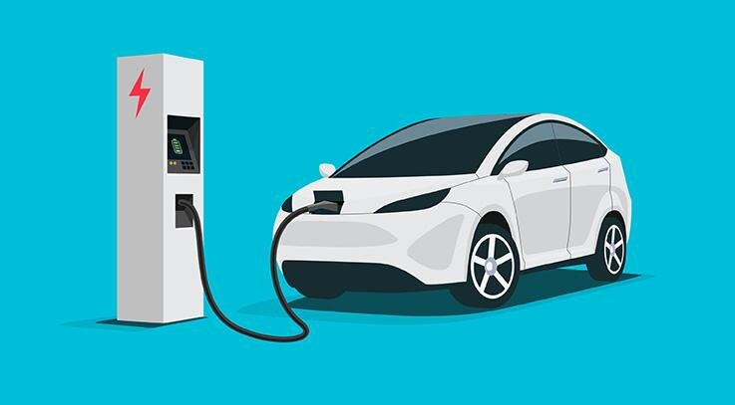
Customer Segment
Target User
Battery manufacturers, electric vehicle (EV) manufacturers, renewable energy system providers, and any industry relying on high-performance batteries.
Indian targeted EV manufacturers
Battery manufacturers

Slide 13
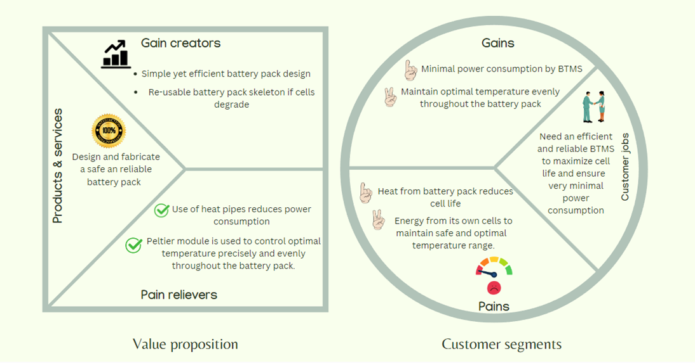
Value Proposition

Slide 14
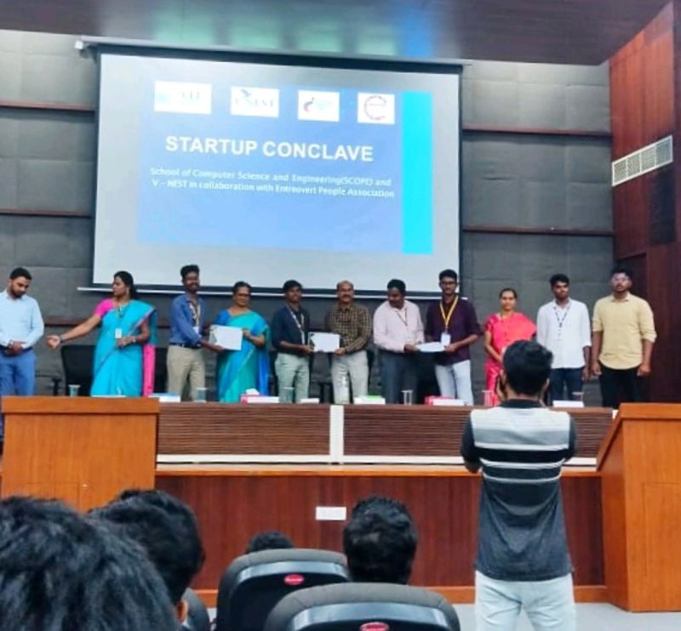
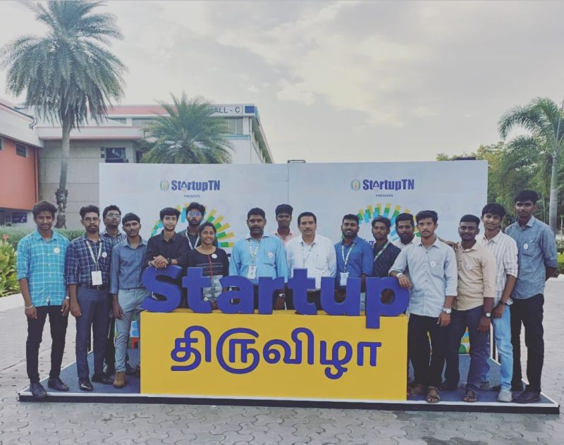
Have you got any awards / recognition ?
WON SILVER AWARD IN STARTUP TN
WON FIRST PRIZE IN VIT STARTUP CONCLAVE

Slide 15
Have you got any other funding support?
GOT FUNDING VIA TBI@KEC
RS.34500

